Slide 1

AI in Healthcare
Assignment 1: MIMIC III Visualization

Slide 2
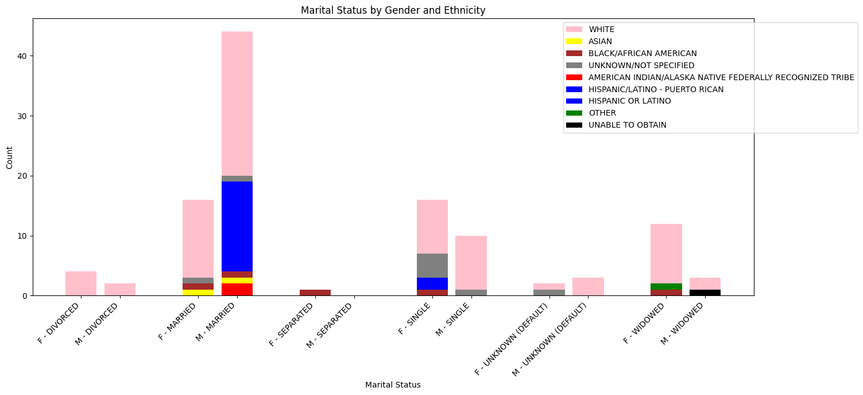
Visualization 1: Demo Data Marital Status by Gender And Ethnicity
Compares the marital status of Women and Men on the Demo MIMIC III Data
Gives ethnicity of different groups using Crosstabs
Dynamic Bar Chart sizing based on number of individuals in each group
Color coding across only ethnicity
Wider spacing between pairs of similar marital statuses

Slide 3

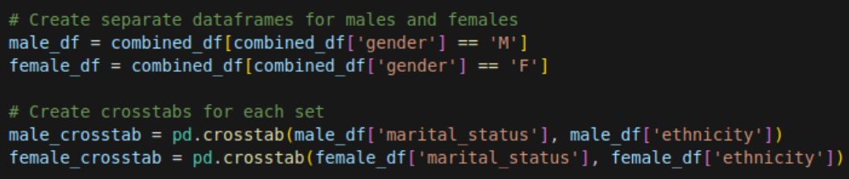
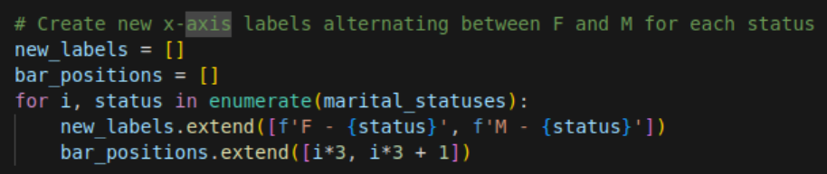
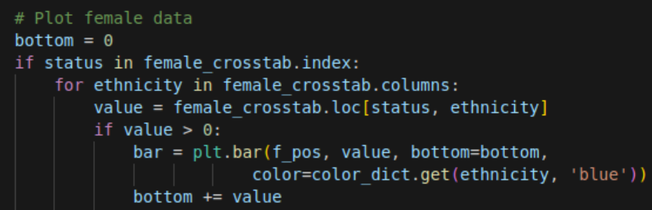
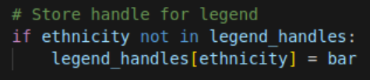
Visualization 1: Under the Hood
I used Demo Data while waiting for the full dataset to download
Data Preparation
Splits dataset into distinct male and female datasets
Creates Crosstab to store ethnicity information
Bar Positioning Logic
Alternating positions for male and female bars
Separate marital status groups
Stacked Bar Creation
Bottom keeps track of where to start next bar in the stack
Each Ethnicity plotted on top of previous bar
Only plot non-zero values
Legend handling
Use a dictionary for distinct Ethnicity-Bar Pairs
Color Consistency maintained across all bars

Slide 4
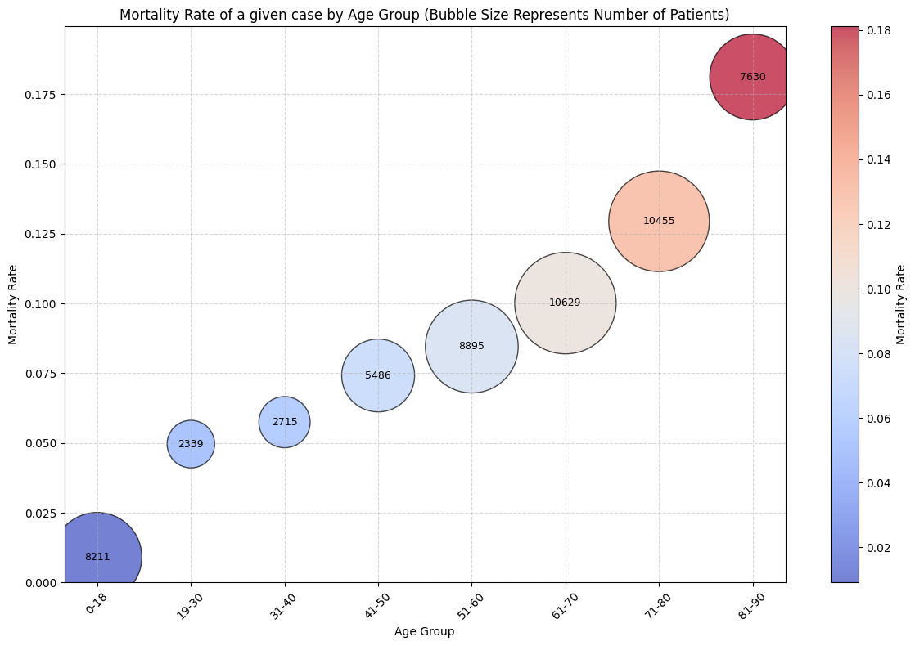
Visualization 2: Bubble Graph of Mortality Rate by Age Group
Data is sourced from the restricted MIMIC III Dataset, rather than the Demo dataset
X-axis is split up by the age groups
Y-axis is the calculated mortality rate
Colors are determined by the calculated mortality rate, with low rates (near 0%) being blue for low risk, and high rates (nearing 18%) being marked red for high risk
Bubble Sizes are determined by the number of patients in the age group, for population sizing to determine outliers

Slide 5

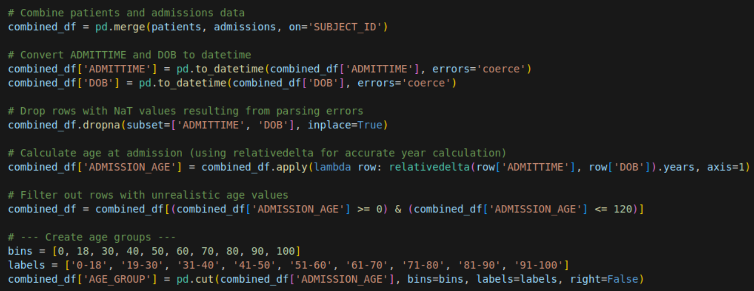
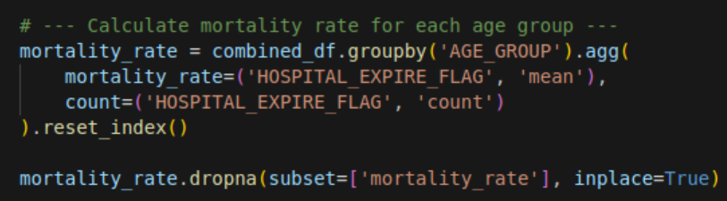
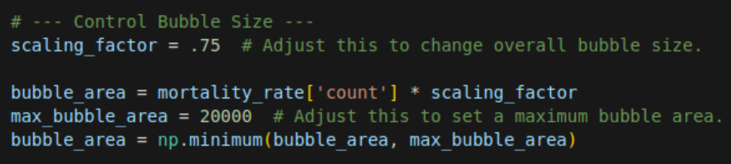
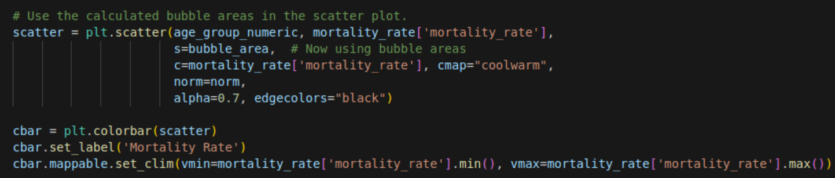
Visualization 2: Under the Hood
Data Preparation & Age Calculation
Combine datasets and drop non values
Calculate Ages using relativedelta library
Create age group bins for different ages of patient
Mortality Rate Calculation
Aggregate mean and count of expired patients
Drop non values
Bubble Sizing
Select scaling factor that works with data
Multiple scaling factor by count to get bubble area
Main Plotting
Utilize size, color, and position to plot values of different bubbles
Separate by age group
Normalize the data
Label Data
Add informative labels to plot
Add number of patients in bins

Slide 6
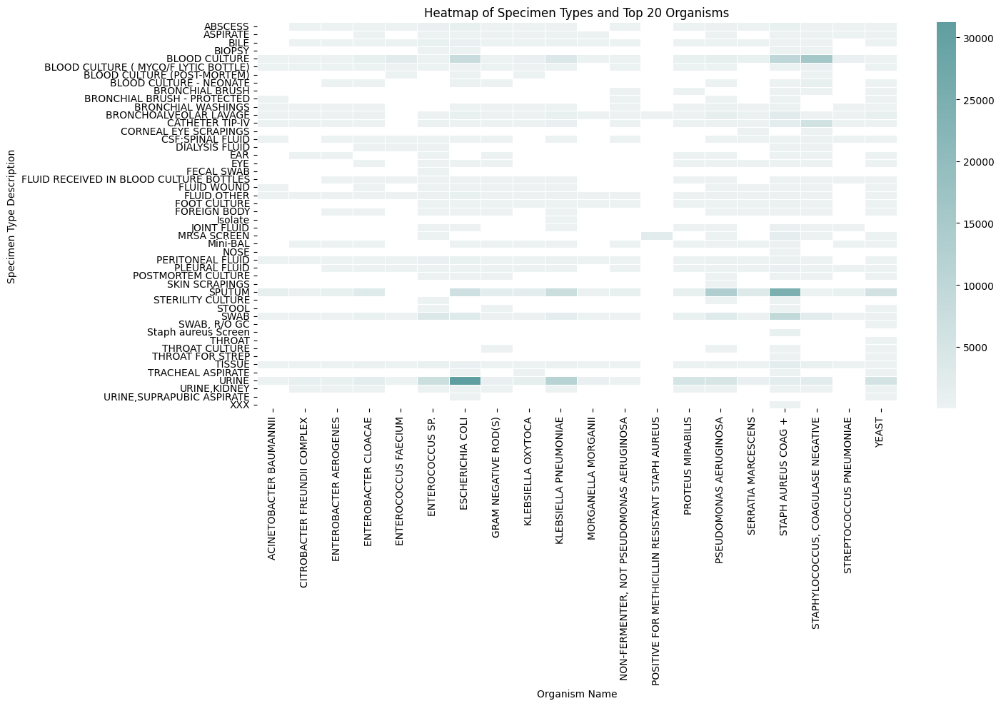
Visualization 3: Heatmap of Tests of Specimens and top 20 Organisms found for MIMIC III full dataset
Used MICROBIOLOGYEVENTS
Heatmap of the type of test with the top 20 most frequent organisms found in testing
Shows which tests are more likely to find which organisms
Some tests are very generic and find a wide variety of Microorganisms, while others are more specific and only used to test for a few
Rows show test specificity
Columns show organism location preference
Darker squares show higher likelihood of finding a particular organism with a given test

Slide 7
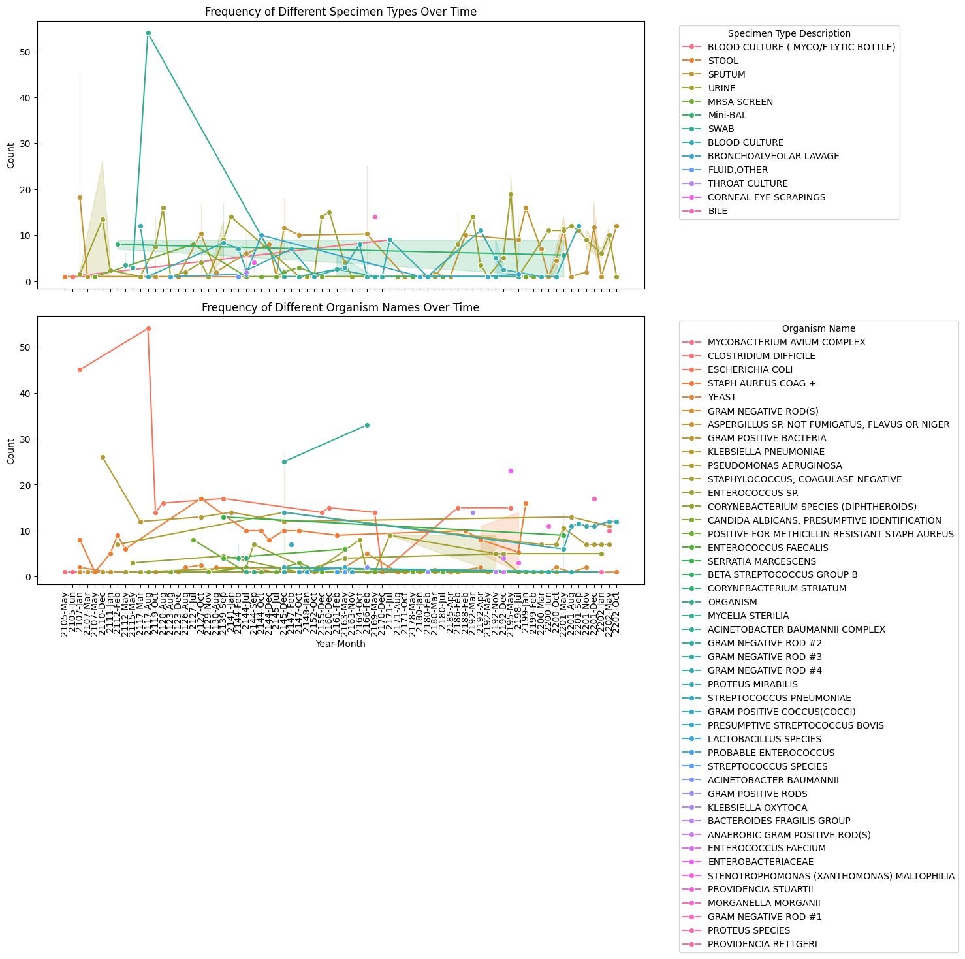
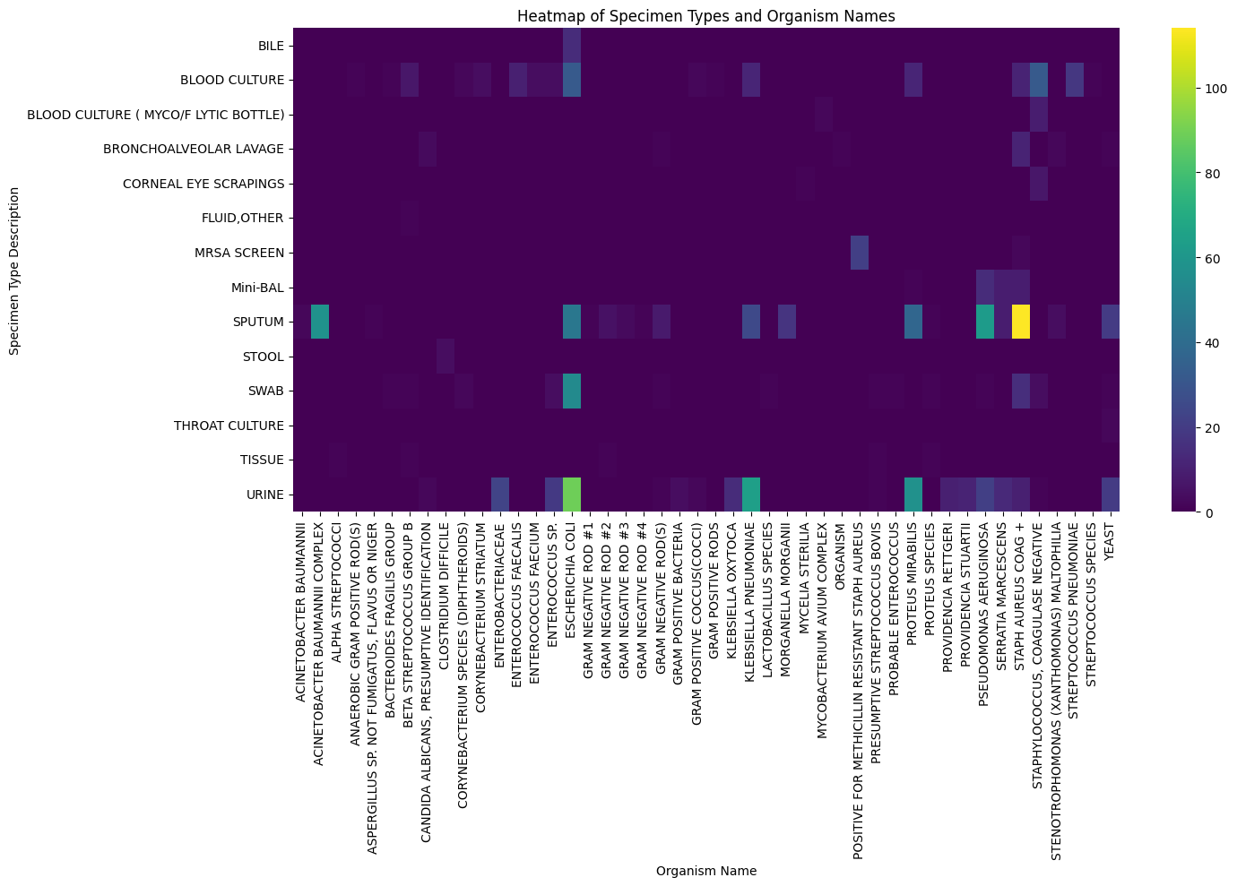
Visualization 3: Bonus
Shows time series data of the frequency of tests being performed and the frequency of organism’s being detected over time, while selecting for common organisms
Shows how some types of organisms (flu) are seasonal, while others are impacted by non-time series data

Slide 8
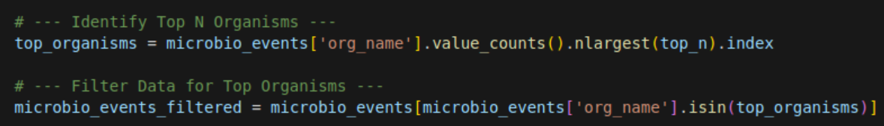

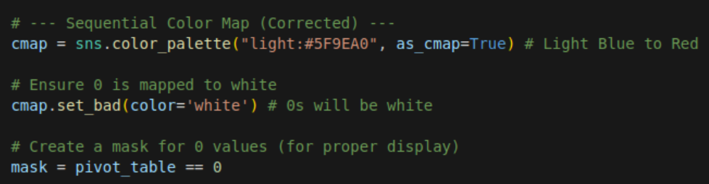
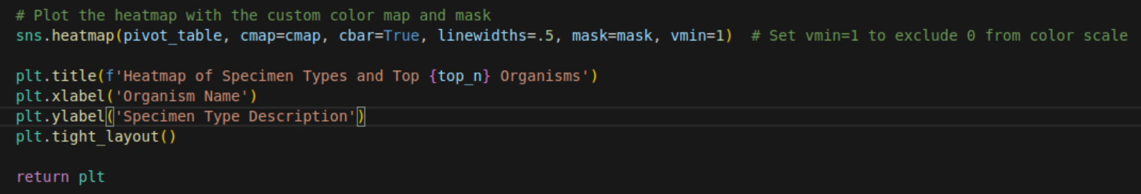
Visualization 3: Under the Hood
Use of a function to make swapping between demo data and real MIMIC III Data easier
Identifying and filtering top n organisms
Creating a heatmap with Seaborn
Color Correction
Values of 0 should be white
Values greater than 0 should progressively get darker blue
Mask off 0 values
Plotting

Slide 9
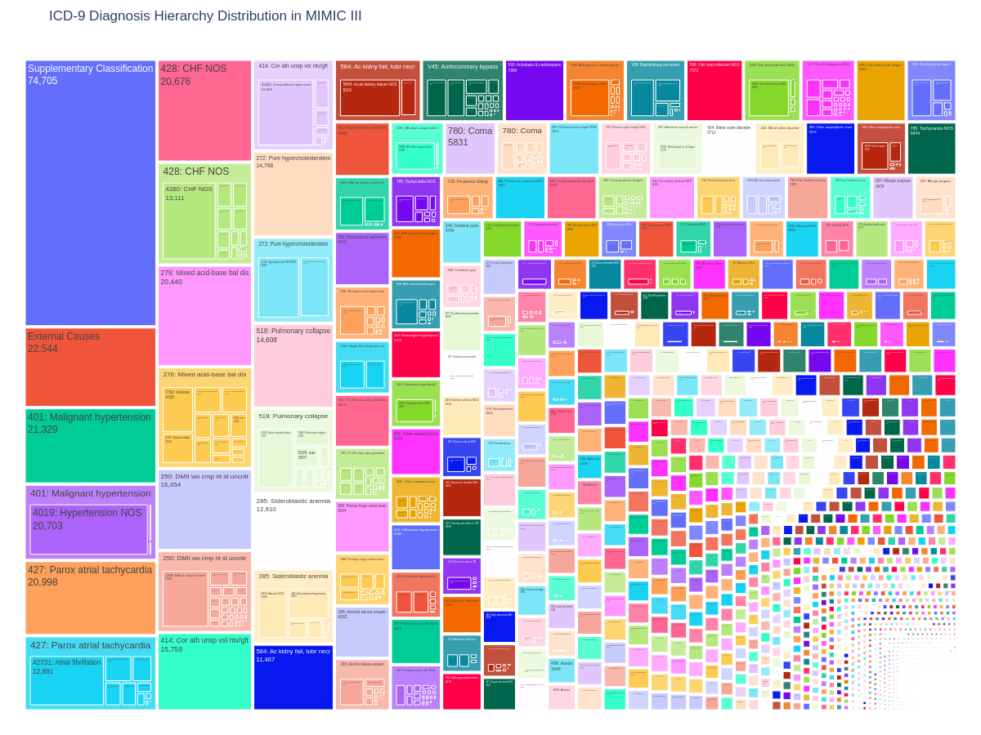
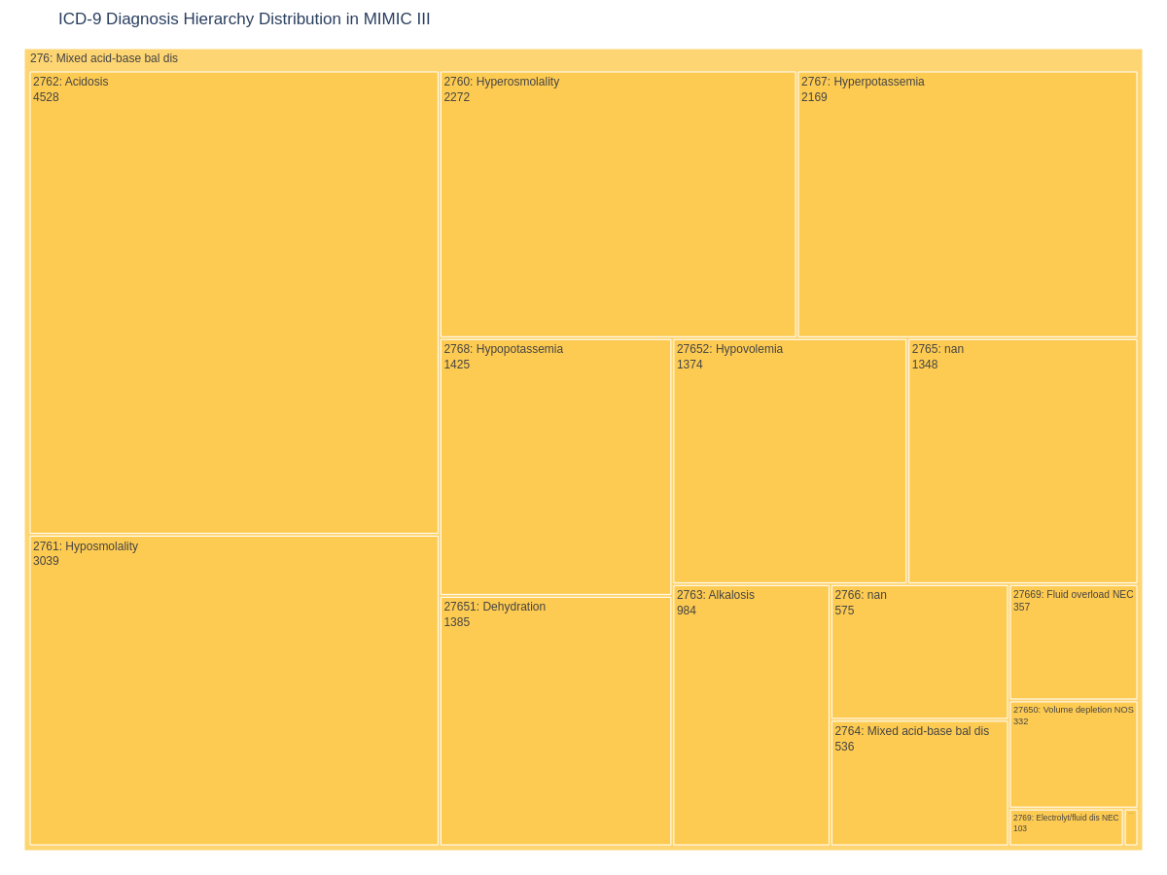
Visualization 4: ICD-9 Diagnosis Hierarchy
Plot of hierarchy of ICD-9 Codes
Dynamic selection of sub-plots using plotly
Gives the high level code categories, and sub categories of potential codes which could be selected
Great way to find out what % of patients diagnosed with one code are classified into a sub condition of that code

Slide 10
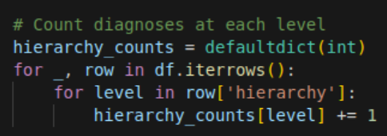
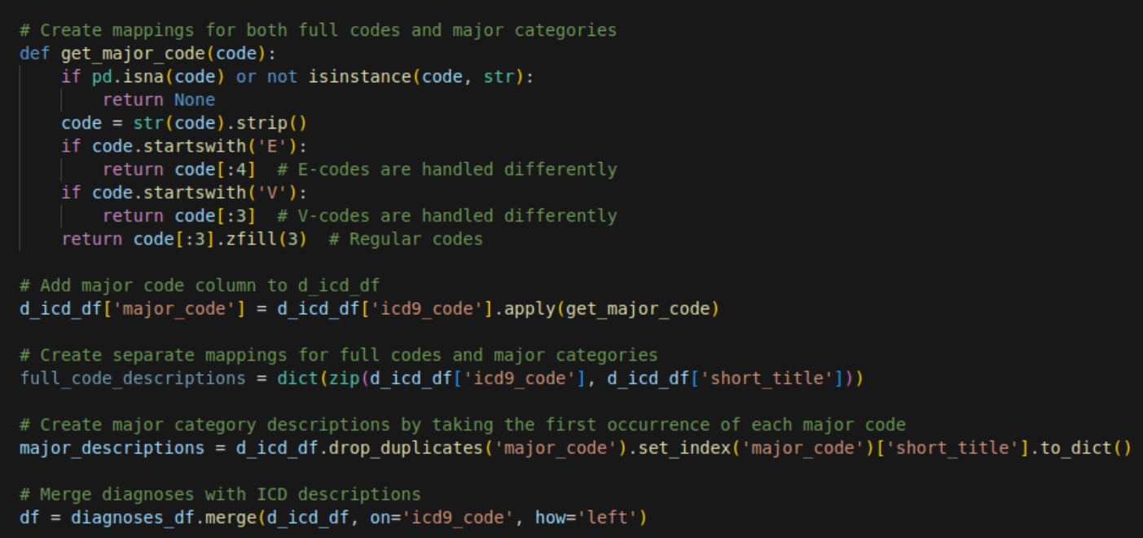
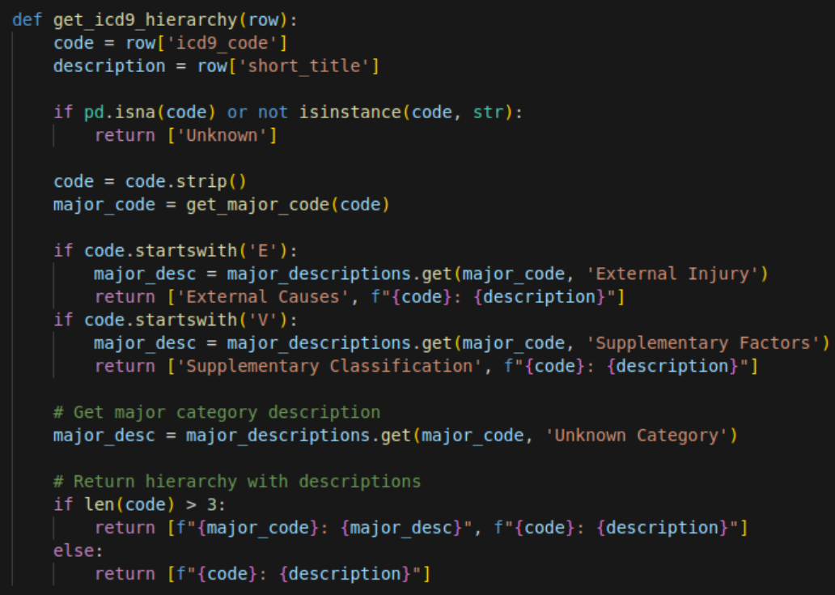
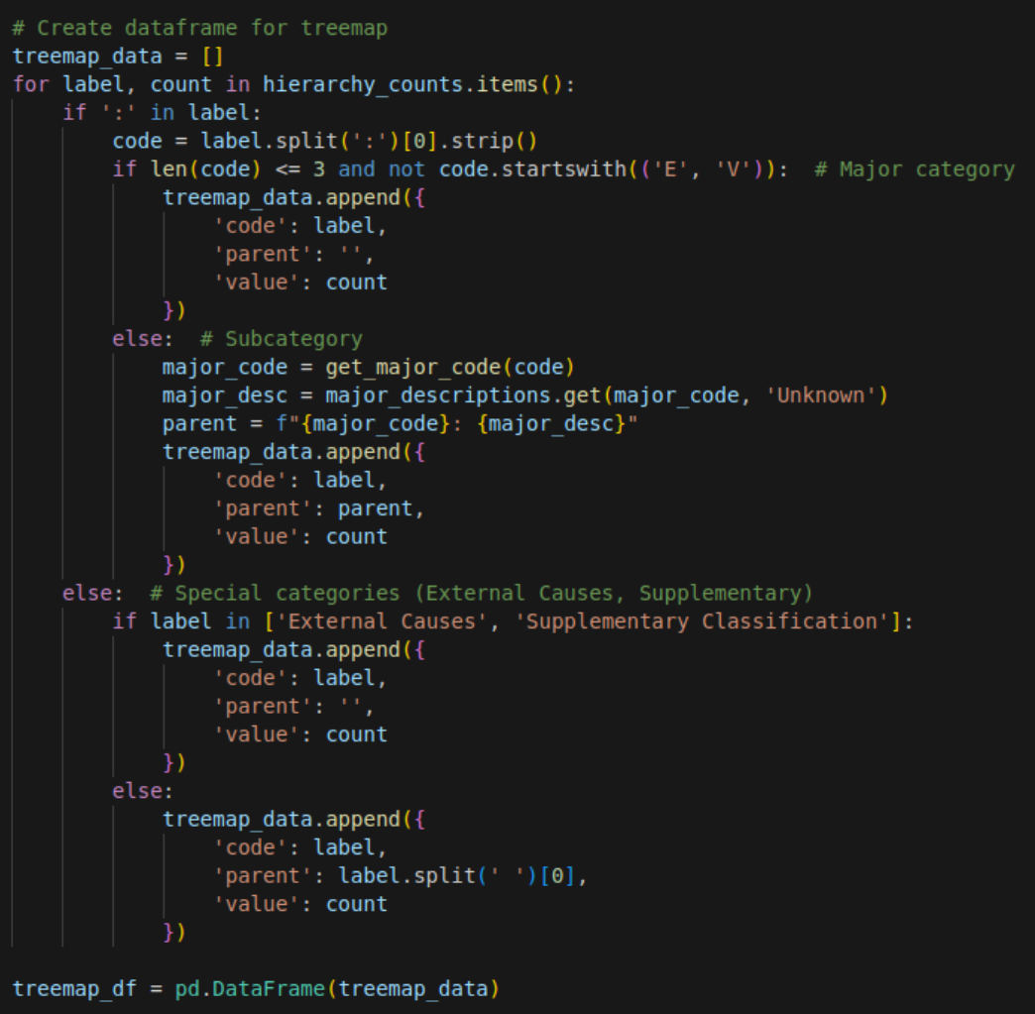

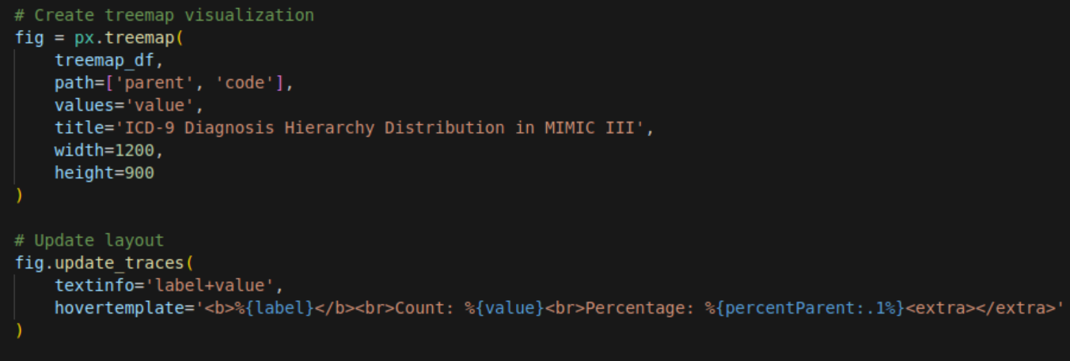
Visualization 4: Under the hood
Create Code Mappings for full codes and major categories
Map category Descriptions for each Code
Build a tree hierarchy of columns
Count diagnosis at each branch of the tree for %’s
Create Tree Map visualization utilizing the codes and %’s

Slide 11
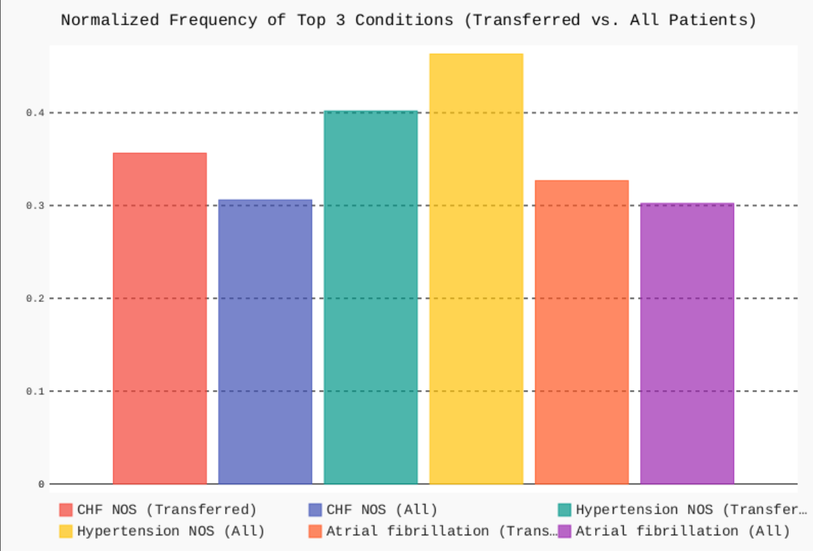
Bonus Visualization: PyGal Library use for Vector Image outputs
PyGal used for Vector .svg outputs of graphs (good for website building)
Compares frequency of conditions in patients who started in one unit, and were transferred to another unit
Helps identify possible conditions that lead to patients being more likely to be transferred
Can be expanded to N numbers of conditions

Slide 12
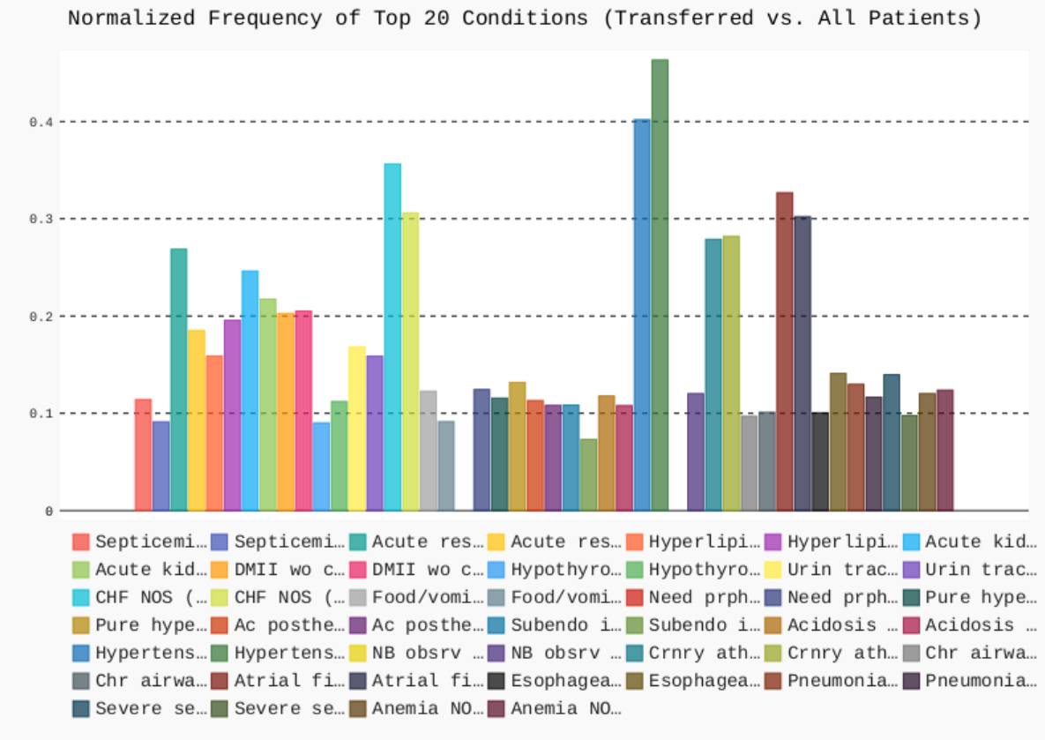
Bonus: 20 Conditions
Notice Some conditions are much more likely than others for transfers
Can be further explored with a heatmap and other graphs, which will be on the next slide

Slide 13
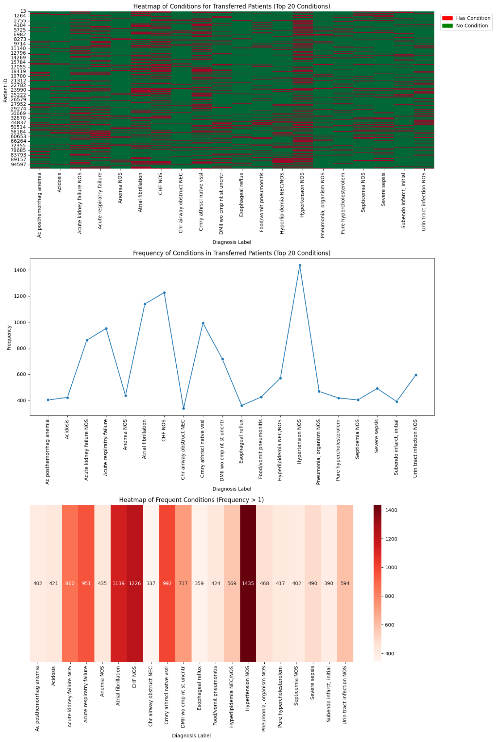
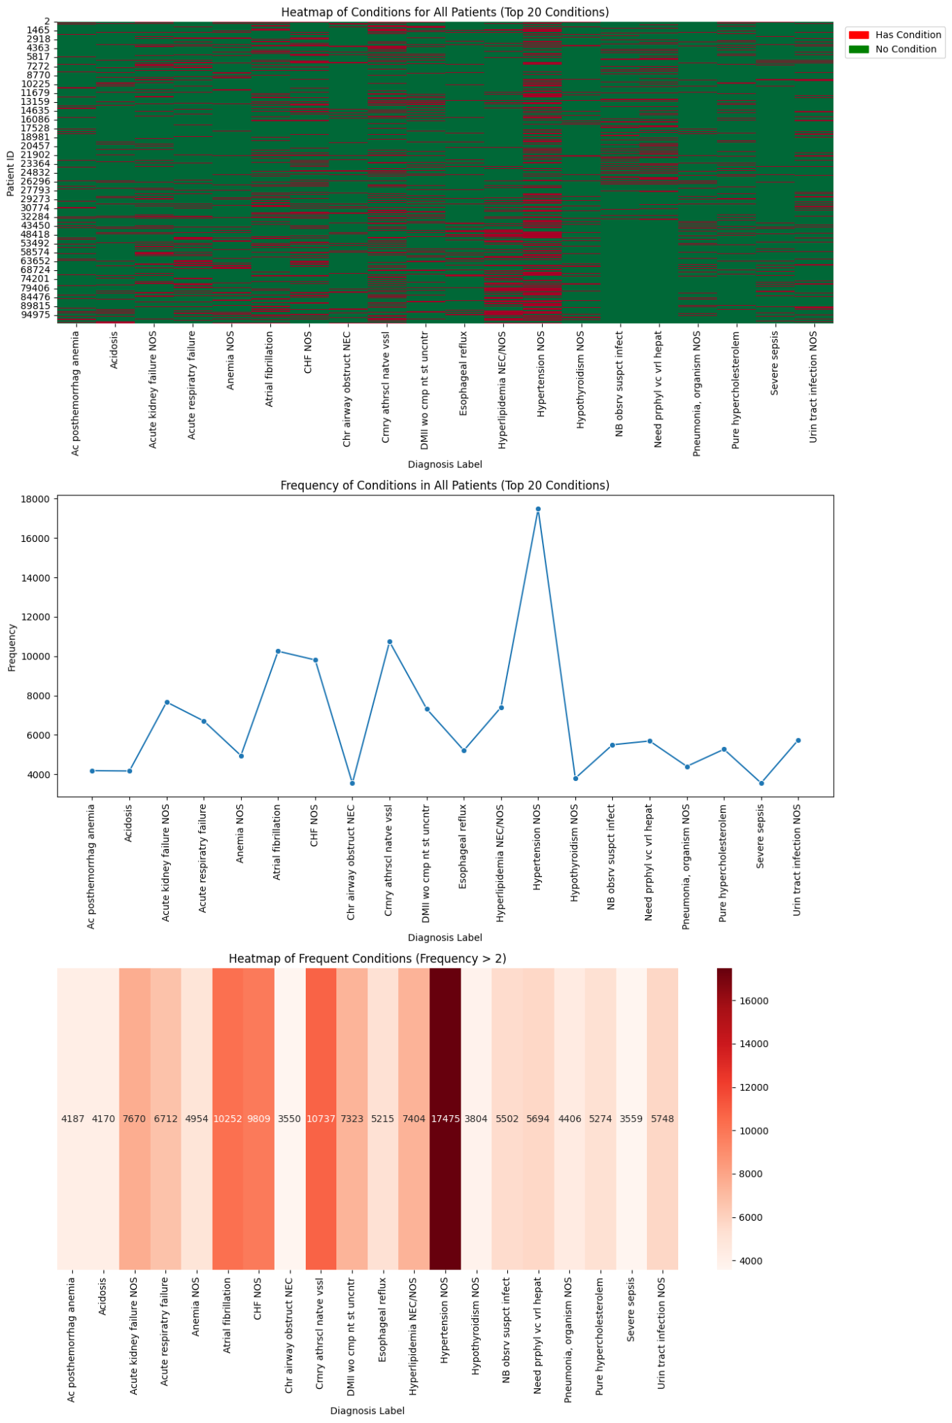
Bonus: 20 Conditions Heatmap And Frequency
Comparison of these conditions frequency in both the transferred population (left) and the full population (right)
Heatmap here shows frequency of certain complications, indicating Hypertension may be a commonality among transferred patients

Slide 14
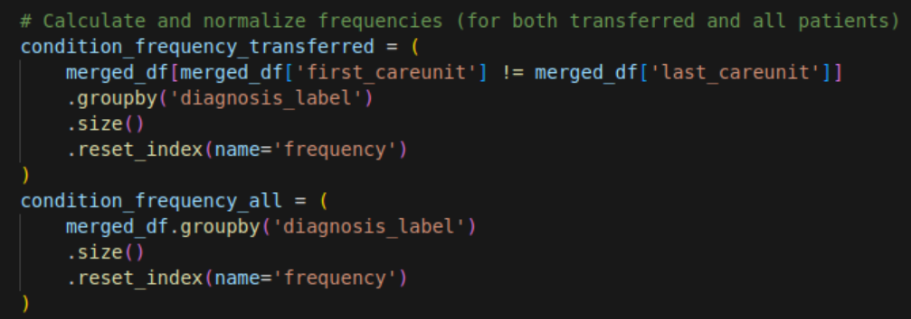

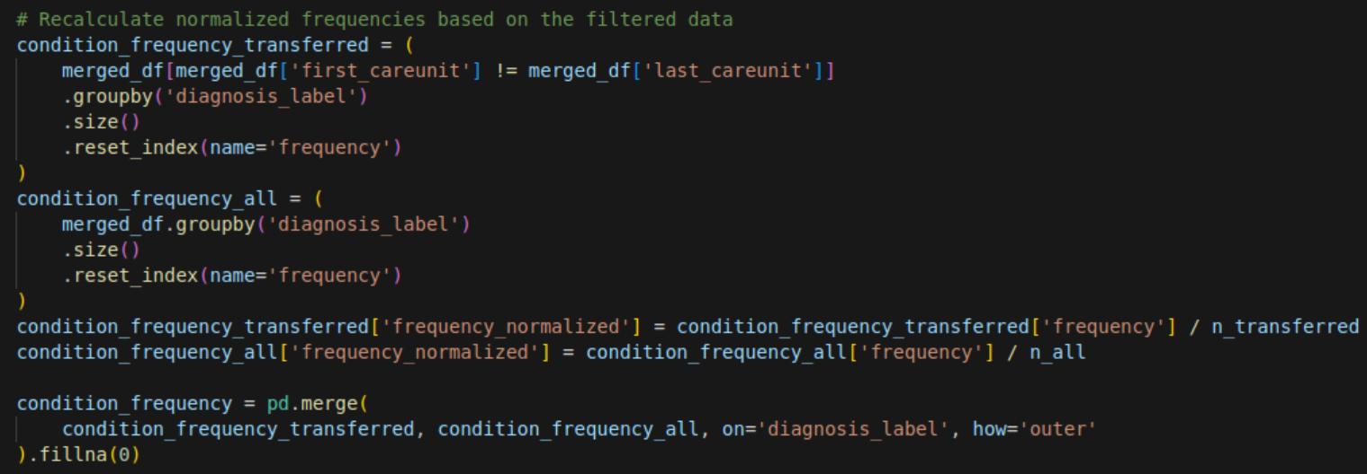
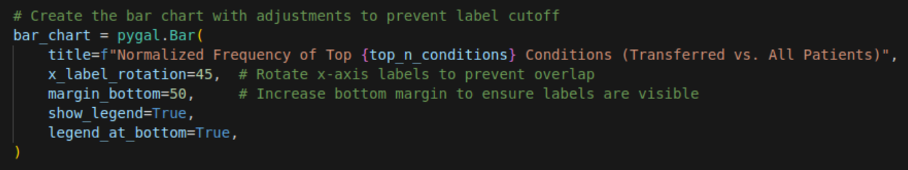
Bonus Code: Under the Hood
Calculate condition frequencies
Select top N conditions
Recalculate and normalize frequencies
Create the final Bar Chart
Iterate through each condition adding in its frequency
Save as an SVG using PyGal

